Slide 1


Optimization of enzyme combinations for shotgun proteomics
Sabrina Khuntia
Gao Lab (College of Pharmacy)

Slide 2

Outline
Research question
Enzymatic property comparison
Catalyzed hydrolysis simulation
Other parameters
Convex hull layering

Slide 3
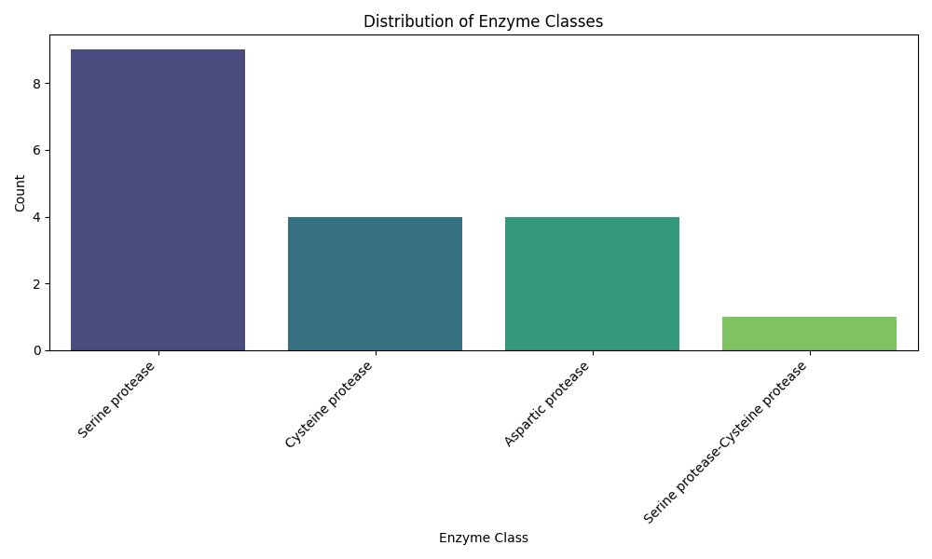
Introduction
Promega mass Spec proteases

Slide 4
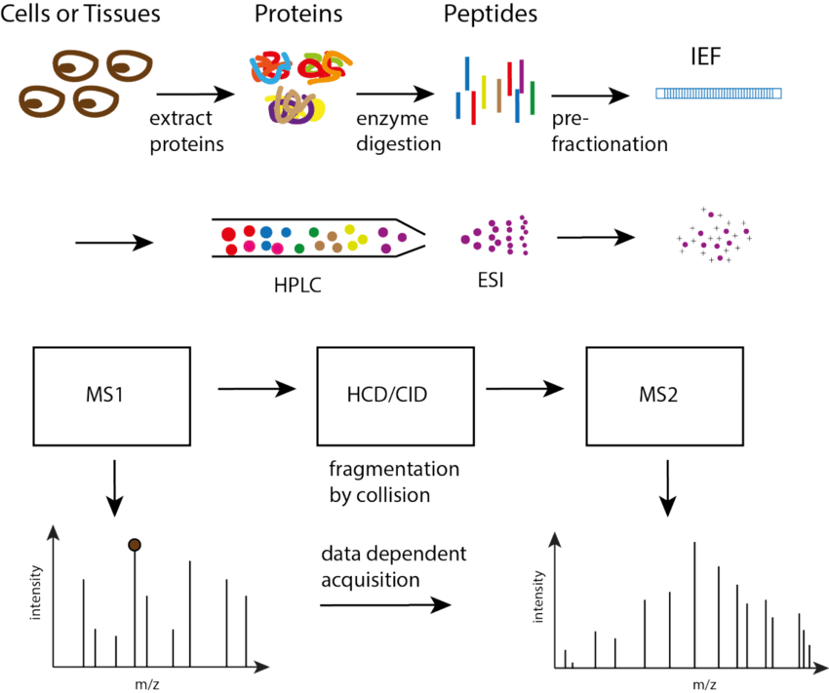
Proteomic workflow

Slide 5
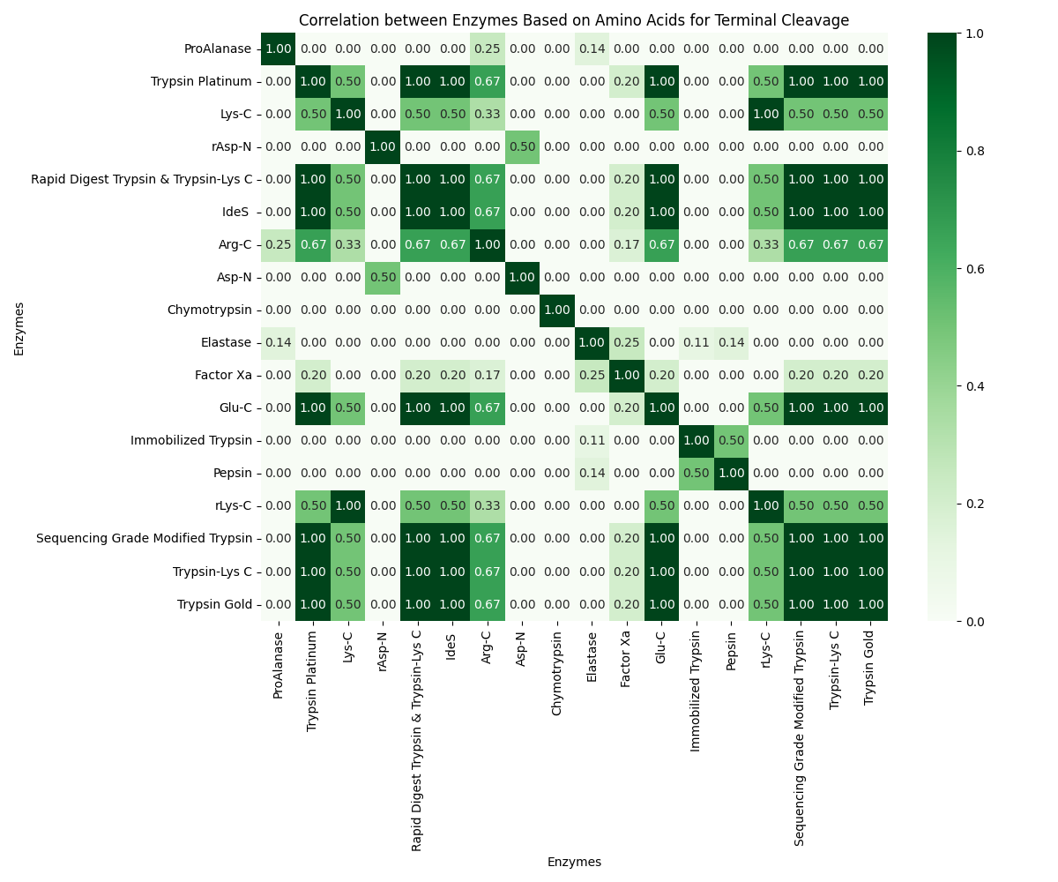

Slide 6
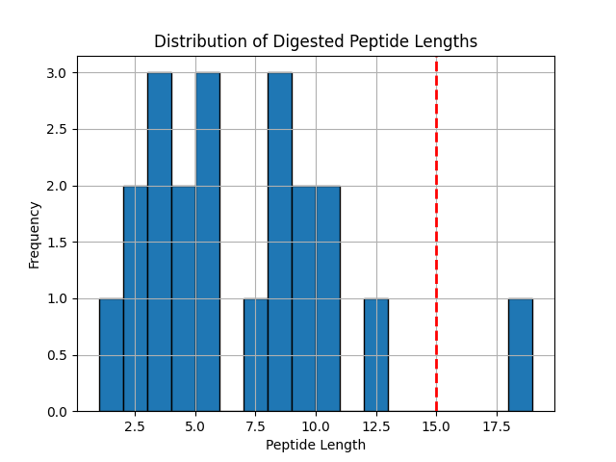
Cleaved peptides using [‘trypsin’] :
Number of peptides that satisfy the mass spectrometer's detectability conditions:
10
Average size of digested peptides: 6.523809523809524
Maximum size of undigested peptides:
19

Slide 7
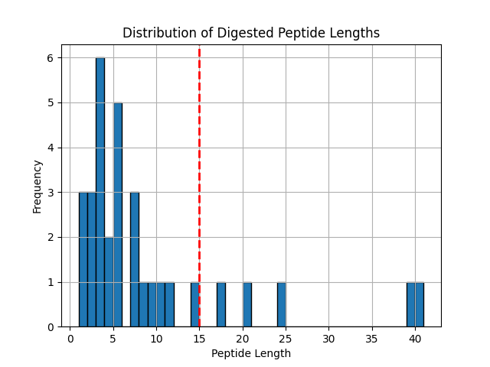
Cleaved peptides using ['chymotrypsin', 'rasp-n'] :
Number of peptides that satisfy the mass spectrometer's detectability conditions: 11
Average size of digested peptides: 8.5625
Maximum size of undigested peptides: 41

Slide 8
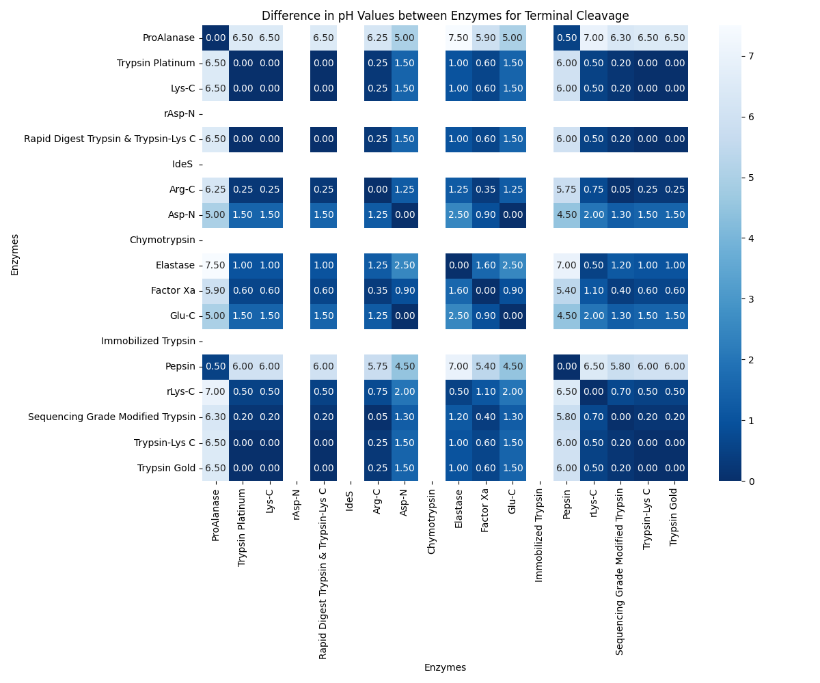

Slide 9
Other Parameters

Slide 10
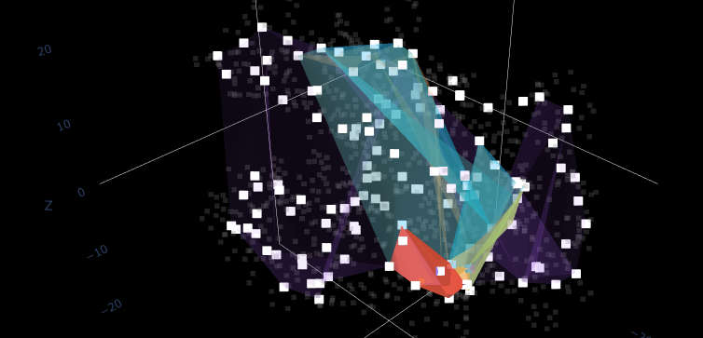
Parameter: Hull Layers

Slide 11

Thank you!

